Slide 1
Session 482 - Strategies to Improve Care for Advanced Chronic Respiratory Diseases
SIMULATION SUGGESTS TRANSCUTANEOUS CO2 SENSORS MAY ACCURATELY DETECT HYPERCAPNIA ACROSS SETTINGS

Slide 2
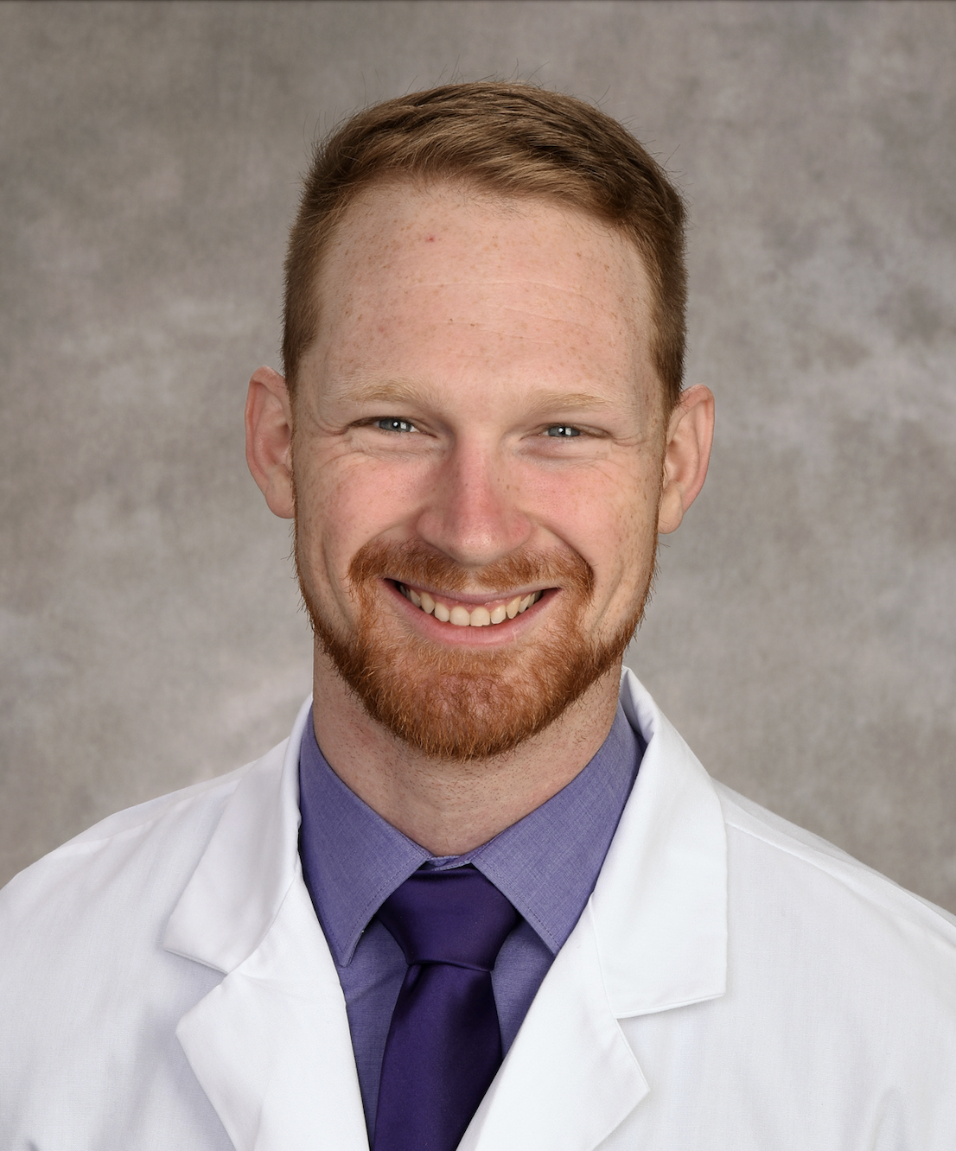
Dustin Anderson-Bell, MD
Fellow of Pulmonary and Critical Care Medicine
University of Utah
Intermountain Medical Center
Carl T. Hayden Veterans’ Administration Medical Center
Salt Lake City, Utah
Disclosure: None.

Slide 3
Financial Disclosure
This research was supported by the National Institutes of Health under Ruth L. Kirschstein National Research Service Award 5T32HL105321 from the NIH.

Slide 4
Lesson Objectives
Why arterial sampling for detection of hypercapnia is problematic
Possible role of Transcutaneous CO2 (TcCO2) monitoring
Current study: Accuracy of TcCO2 in detection of hypercapnia

Slide 5
Background
Problem:
  Hypercapnia is widespread (~15% of CAP admissions¹, 43% of ARDS²) and consequential (Hospital mortality of 53% for ICU patients treated with NIV for acute hypercapnia³).
  Diagnostic gold standard = Arterial sampling – painful with possible complications; may limit sampling⁴.
  Accurate detection of elevated arterial CO₂ (PaCO₂) is essential for studying hypercapnic respiratory failure.
Gap:
  Requiring ABG sampling may deter research participation. TcCO2 may offer an adequate alternative. The operating characteristics of TcCO₂ sensors are uncertain.
1 - PMID: 22677348
2 - PMID: 32589951
3 - PMID: 22586805
4 - PMID: 26628461

Slide 6
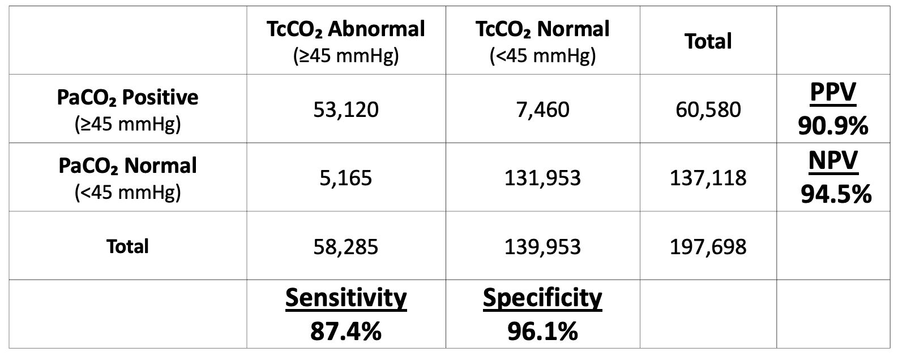
TcCO2
Prior analysis:
  Application of published TcCO2-PaCO2 agreement estimates (Conway et al., 2019) to a national sample of hospitalized patients who underwent PaCO2 sampling (TriNetX database) to obtain simulated test characteristics of TcCO2 for the detection of hypercapnia.
  Results: Good agreement between modalities
Anderson-Bell DM, Brown J, Gouripeddi R, Locke BW. Is an arterial blood gas necessary to detect hypercapnia? An in-silico simulation of transcutaneous CO₂ to identify hypercapnia. Presented at: American Thoracic Society International Conference; May 2025; San Francisco, CA.

Slide 7
Aim of current analysis
Determine accuracy of TcCO2 in characterization for patients in different settings (Ambulatory, inpatient/Emergency Department, ICU)

Slide 8
Methods
Step 1: Collect TriNetX Data
Step 2: Split by Location of ABG sampling
Step 3: Simulation
Inpatient + ED
(n=91, 503)
TriNetX Database
- 76 medical centers
- 115 million patients
- All encounters 01/01/22 – 12/31/22 with an ABG
197,698 ABGs
- 55% male
- 65% white, 14% Black, 4% hispanic
- Age = 61 ± 17 years
- 31% Invasive ventilation
Accuracy of hypercarbia characterization by TcCO2 in each location
(ie PaCO2 And TcCO2 agree on presence of absence of hypercarbia)
ICU
(n=66,704)
Simulated location-specific TcCO2 (using Conway et al. 2019 PaCO2-TcCO2)
Ambulatory
(PFT Lab)
(n=10,456)
QR Code Here

Slide 9
Results
 | Median PaCO2 (IQR) | TcCO2 False Positives (PaCO2<45 TcCO2>45) | TcCO2 False Negatives (PaCO2>45 TcCO2>45) | TcCO2 Sensitivity | TcCO2 Specificity | TcCO2 PPV | TcCO2 NPV
Ambulatory | 40.0 (35.7, 45) | 3.8% | 2.4% | 89.8% | 94.4% | 85.2% | 96.3%
Inpatient/ED | 40.0 (35, 46) | 2.0% | 5.1% | 82% | 97% | 91.9% | 92.8%
ICU | 39.0 (33, 47.2) | 3.3% | 2.2% | 92.6% | 94.9% | 89.5% | 96.5%

Slide 10
Results

Slide 11
Results
(TcCO2 cutoffs of ≤40 and ≥50)
 | False Positives if TcCO2 >50 | False Negatives if TcCO2 <40
Ambulatory | 0.06% | 0.00%
Inpatient/ED | 0.05% | 0.46%
ICU | 0.09% | 0.06%
Sens/Spec/PPV/NPV all >99%

Slide 12
Conclusions
High degree of accuracy in TcCO2 for binary assessment of hypercapnia is preserved across multiple different clinical settings.
  Very good accuracy if using cutoffs of ≤40 and ≥50.
Greatest amount of inaccuracy = false negative rate for emergency and non-ICU inpatients (5.1%)
Limitations:
  Patients who have sampling of their PaCO2 may have more extreme derangements than those who do not undergo sampling
  Inability to separate emergency department patients from non-ICU hospitalized patients given the nature of the data available from the meta-analysis used.

Slide 13
Thank You!
Don’t forget to evaluate this session in the app.

